Slide 1
Team member ♦ Abdelrahman Shrief Ali ♦ Mahmoud Mohamed Elbhrawy ♦ Mahmoud Mohamed Atef ♦ Rana Ahmed Mahmoud ♦ Eslam Ahmed Ibrahim ♦ Ali Osama Ebied
Smart Home Application

Slide 2
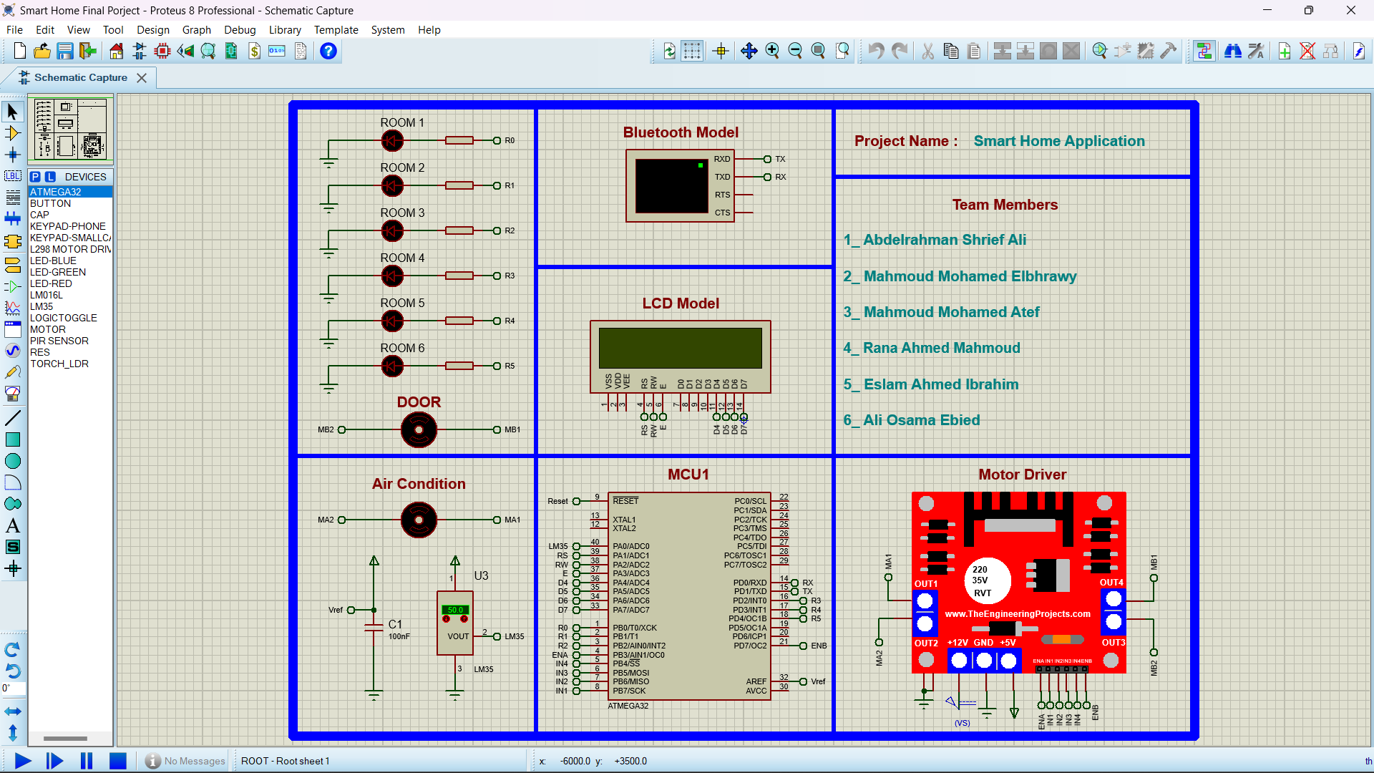
Smart-Home
Smart Home gives you many features such as controlling room lighting and door via Bluetooth, displaying the temperature , controlling the temperature and Auto Air condition.

Slide 3
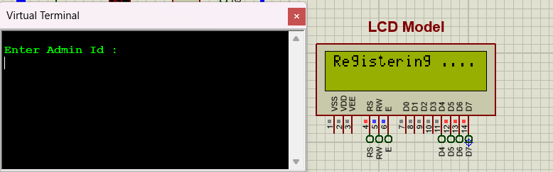
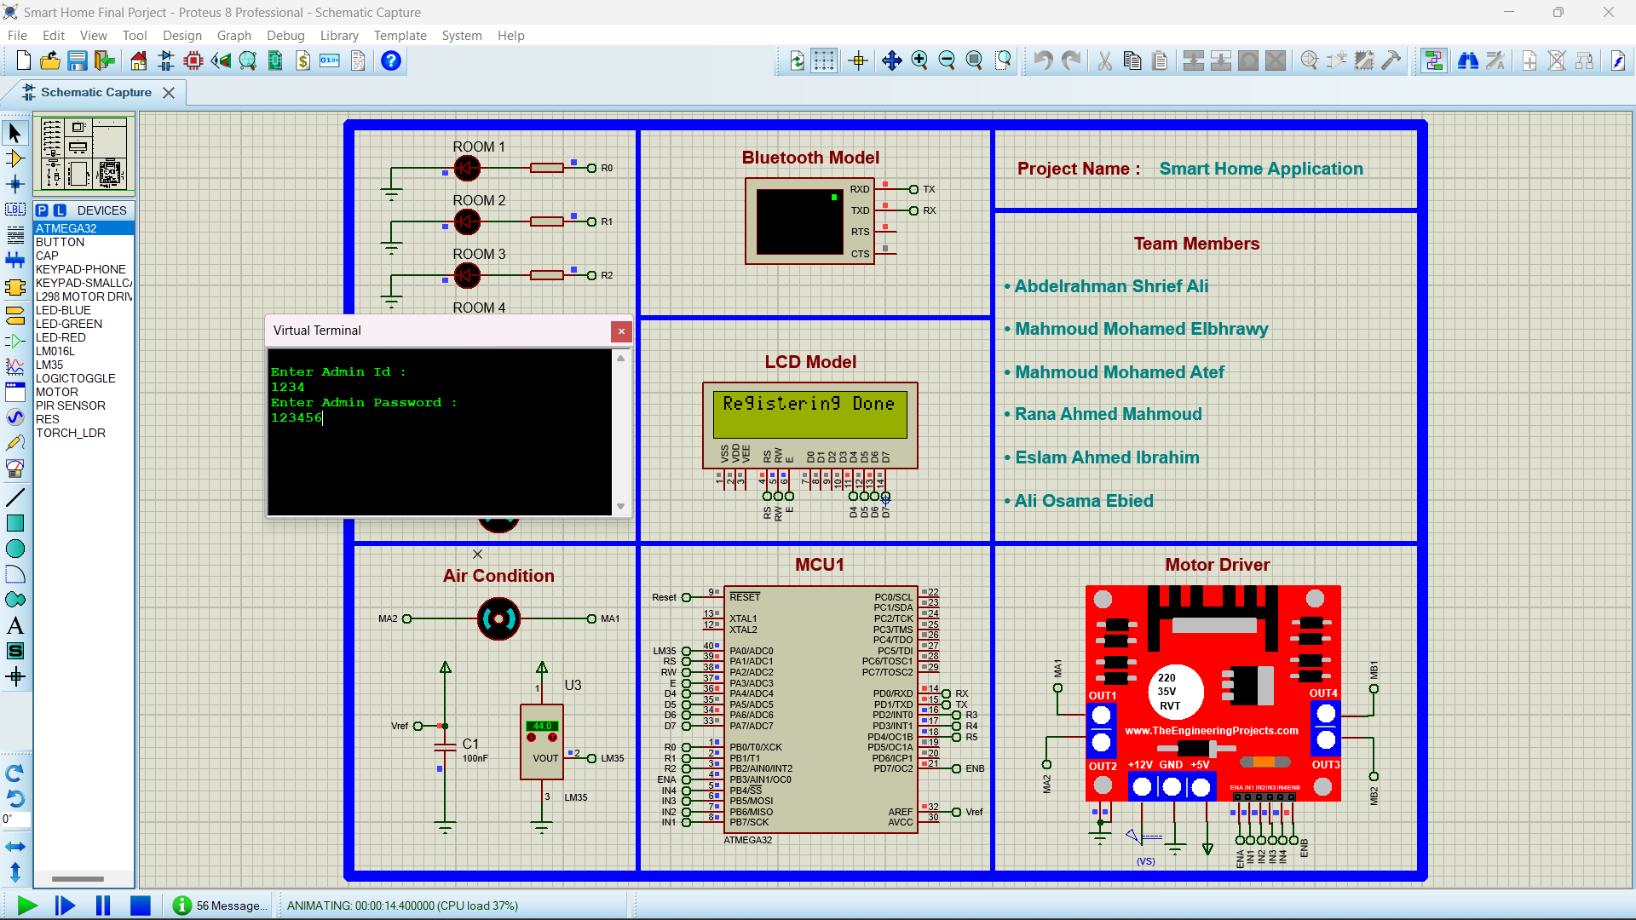
To use the smart home follow these steps
• Set admin ID and password

Slide 4
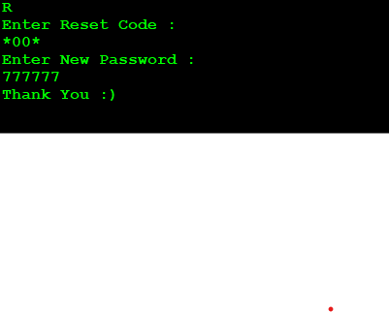


• Enter “R” to reset admin password (reset code: ”*00*” )
• Enter “U” to add user
• Enter “D” to delete user

Slide 5
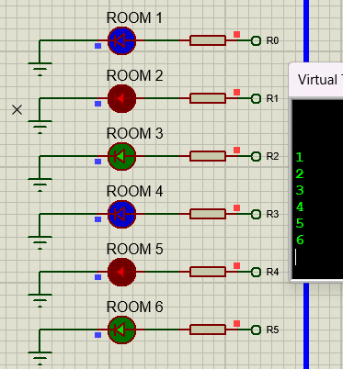
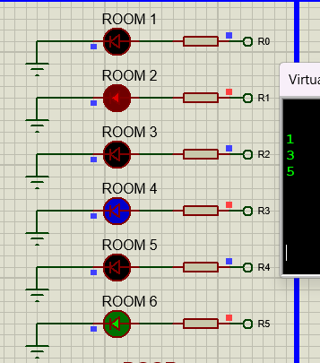
• Enter “1” for toggelling LED1
• Enter “2” for toggelling LED2
• Enter “3” for toggelling LED3
• Enter “4” for toggelling LED4
• Enter “5” for toggelling LED5
• Enter “6” for toggelling LED6

Slide 6
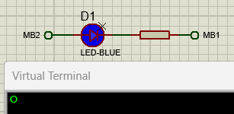

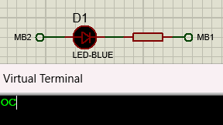

• Enter “o” to open the door
• Enter “c” to close the door

Slide 7
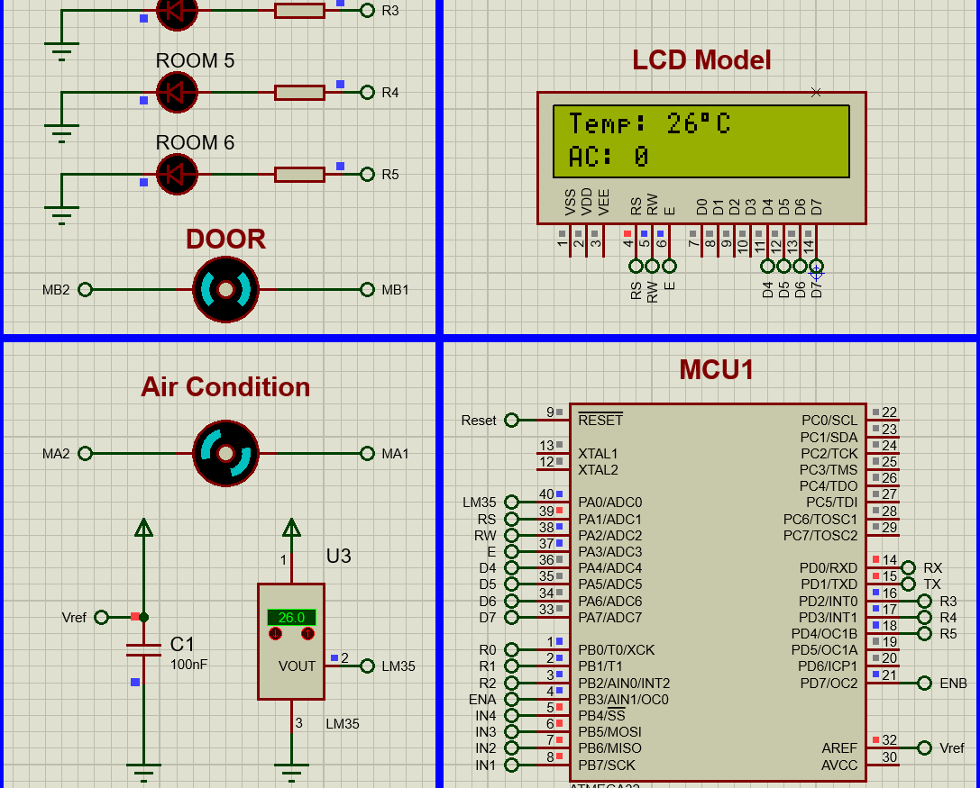
First Condition when Temperature is less than or equal 27 ,Then The Ac Will Still in lazy mode.

Slide 8
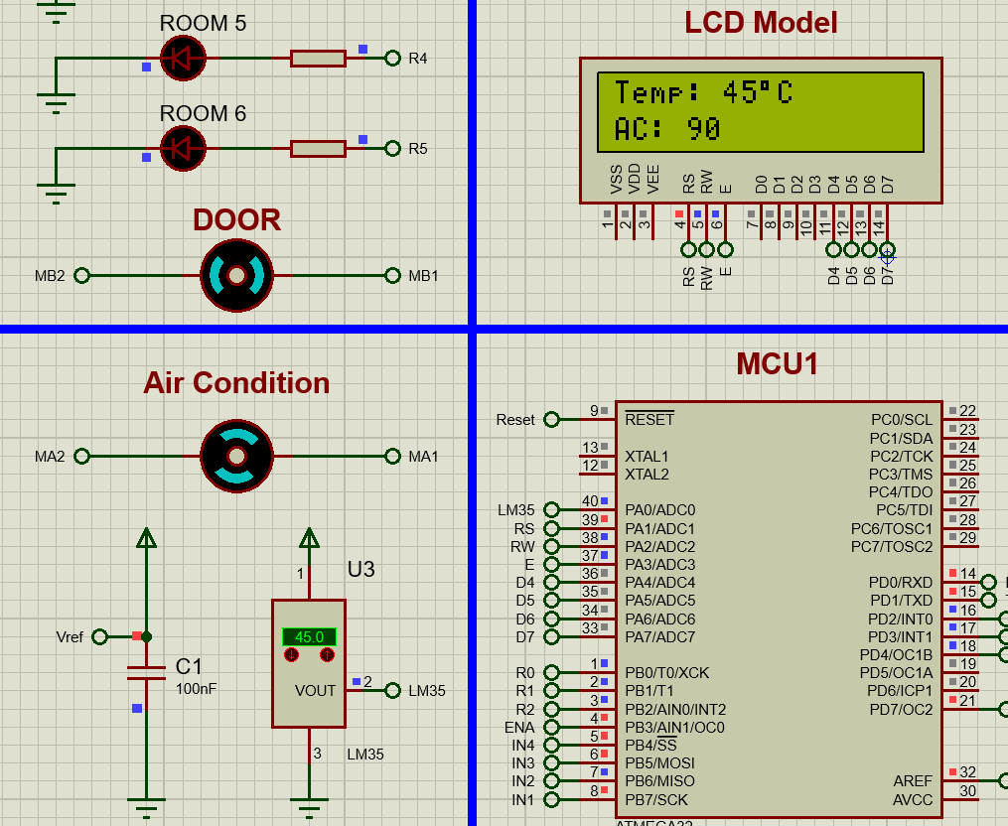
Second Condition when Temperature is More than 27 ,Then
The Ac will turn on with speed related to the temperature.

